Slide 1
Event Driven Architecture
Patterns
Cloud Garage Solution Engineering
Notes:
This should be my unique deck

Slide 2

Table Of Content
Why EDA in 2018?
Microservice Challenges
Reference Architecture
Kafka and Event Streams
Event Storming Methodology
Even-driven design patterns
Reference Implementation
Data replication for continuous availability
Real time analytics and AI

Slide 3
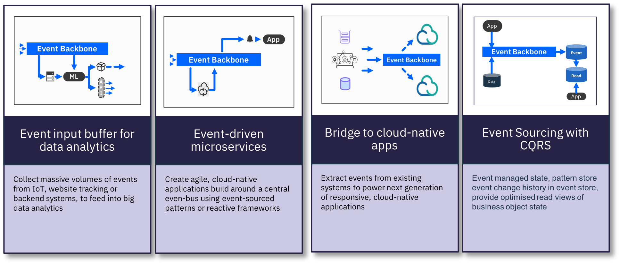
Event Driven Application Patterns

Slide 4
Event Sourcing: From a relational model…
Product ref
Quantity
Product type
Orders
Shipment Order
Product ref
Quantity
updates the previous state of each business entities
Addresses
Shipping Address
Pickup Address
Products
https://ibm-cloud-architecture.github.io/refarch-eda/evt-microservices/ED-patterns/

Slide 5
To a sequence of events - Event Sourcing
Shipment Order
Created
Pickup Address
Added
3 Products
Added
Shipping Address
Updated
Order
Committed
Immutable
Only append
Keep a log of all the changes
Time
https://ibm-cloud-architecture.github.io/refarch-eda/evt-microservices/ED-patterns/
Notes:
How many of you have delete statement in your database?
How do you define the data have no value?
How to do cost benefit analysis about information?

Slide 6
Event Sourcing - Benefits
Shipment Order
Created
Pickup Address
Added
3 Products
Added
Shipping Address
Updated
Remove one Product
Does not loose information
Keep facts
Derive state from facts
Auditing
Time based query
Behavior pattern over time
Time
Notes:
Is it the same has having 2 products in the order?
It depends. If you consider the data in a relation manner it does equal to two products. If you want to count the number of time product are removed from an order than it matter to keep the event.

Slide 7

Event Sourcing
UI Web SPA
BFF
Order Mgt MS
USER
Publisher
offset
Order
Consumer
Order Created
Order Updated
Order Updated
Order Pending
Order Booked
Order Confirmed
Order Assigned
Order Shipped
Order In Transit
Order Delivered
Time
Immutable Ordered Events
Offset read / committed
Replay and auditability
Key example: OrderID

Slide 8
Event Sourcing
Order Mgt MS Pod
offset
Order
Order Created
Order Confirmed
Order Shipped
Order In Transit
Snapshot
Order Delivered
Order Created
Order Updated
Order Updated
Order Confirmed
Order Shipped
Order Mgt MS
Pod
Time
When a pod crashes, the new instance can reload from a previously committed offset, or from the last snapshot
https://chriskiehl.com/article/event-sourcing-is-hard

Slide 9
Integration tests to proof event sourcing
What happened to order ID 75?
Order producer
Simulator.py
Order Created
Order Confirmed
Order Shipped
Order In Transit
Snapshot
Order Delivered
Order Created
Order Updated
Order Updated
Order Confirmed
Order Shipped
Order consumer
Whathappen.py
Time
https://ibm-cloud-architecture.github.io/refarch-kc/itg-tests/ - replay-all-events-for-a-given-key

Slide 10
Order Life Cycle
Order Settlement
Create Order
Order Created
Confirm Order
Update Order
Order Updated
Confirm Order
Order Booked
Voyage found
Allocate Voyage and
Container
Order Completed
Cancel Order
Order Assigned
Order Cancelled
Order Rejected
Notes:
It is important to work on the main business entity life cycle, assess the state and event notifications created when state changes. This is the combination of events and actions

Slide 11
Eventual Data Consistency

Slide 12
CAP Theorem
Web based services could not ensure consistency, availability and partition tolerance all at the same time, They can, at most, support only two out of the three.
ACID provides consistency for partitioned databases.
BASE (Basically available, soft state, eventually consistent) focuses on availability.
“it is better to have availability along with eventual consistency rather than compromising on availability on the whole”.

Slide 13
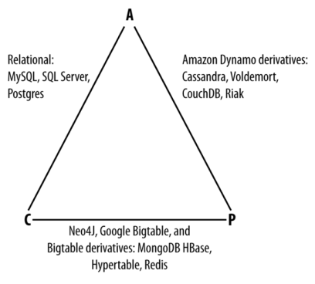
CAP Theorem
A distributed computer system can have at most two out of three following properties: Consistency, Availability, and tolerance to network Partitions.
Consistency All database clients will read the same value for the same query, even given concurrent updates.
Availability All database clients will always be able to read and write data.
Partition tolerance The database can be split into multiple machines and it can continue functioning in the face of network segmentation breaks.
13
Notes:
In Cloudant, consistency is sacrificed in favor of availability and partition tolerance. Specifically, Cloudant is an eventually consistent database, which means that no locking occurs when data is written and inconsistencies are allowed for a time. In other words, systems that rely on eventual consistency assume the data will be in an inconsistent state at some point and handle the situation by postponing the operation, using the data as-is, or ignoring certain pieces of data. Eventual consistency systems are easier to reason about but not all data models or operations fit its semantics. Eventual consistency is useful in the context of big volumes of data.
This is not suitable for ACID transactions
Eventual consistency is sometimes criticized as increasing the complexity of distributed software applications. This is partly because eventual consistency is purely a liveness guarantee (reads eventually return the same value) and does not make safety guarantees: an eventually consistent system can return any value before it converges.

Slide 14


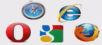
Modern microservice architecture (2017)
API focus
Multi channels
Database per service
Mobile Apps
B2B
Browsers
API Gateway
SPA
Authentication MS
User management MS
App Authorization MS
Config management MS
Product management MS
Order MS
Inventory MS
Notes:
Here is a traditional modern architecture with some focus on API and channels. The solution leverages microservice with “database per service pattern”.
suppose we need to solve the following task:
Register a user profile
Do some automated background check that the user can actually access the system
The second task is to ensure, for example, that this user wasn’t banned from our servers for some reason.
But it could take time, and we’d like to extract it to a separate microservice. It wouldn’t be reasonable to keep the user waiting for so long just to know that she was registered successfully.

Slide 15
Eventual Data Consistency
Product Web
Order Web
Inventory Web
CRUD works for totally isolated data but becoming hard to do cross domain services with consistency.
A new product defined in the ‘product management MS’ is propagated via REST calls to other services
A new service added, interested by the new product, enforces changing the product management MS code.
CRUD
CRUD
CRUD
Product management MS
Order MS
Inventory MS
Query on the Order microservice may not see the last product… eventually it will see it.
Or better … Order and Inventory calls Product APIs… still there is eventual consistency
Notes:
Each microservice could have its own administration user interface, which CRUD elements in the database.

Slide 16

Eventual Data Consistency
Product Web
Order Web
Inventory Web
CRUD
CRUD
CRUD
Product management MS
Order Assess MS
Inventory MS
Event sourcing should help
Events are persisted in a single commit
Microservices are event producer / consumer
Event Backbone
0
1
2
3
4
5
6
7
Notes:
Each microservice becomes a producer of events with data payload, and consumers for writing to its own database or build view from other microservices
In this architecture, a happy scenario would be:
The user microservice registers a user, saving information about her in its local database
The user microservice marks this user with a flag. It could signify that this user hasn’t yet been validated and doesn’t have access to full system functionality
A confirmation of registration is sent to the user with a warning that not all functionality of the system is accessible right away
The user microservice sends a message to the validation microservice to do the background check of a user
The validation microservice runs the background check and sends a message to the user microservice with the results of the check
If the results are positive, the user microservice unblocks the user
If the results are negative, the user microservice deletes the user account
After we’ve gone through all these steps, the system should be in a consistent state. However, for some period of time, the user entity appeared to be in an incomplete state.

Slide 17
SAGA Pattern
A long running transaction that can be broken up to a collection of sub-transactions that can be interleaved any way with other transactions. Src Garcia-Molina, Salem 1987
With microservice each transaction updates data within a single service, each subsequent step may be triggered by previous completion.
Order MS
Voyage MS
Container MS
Ship Mgt
1
Order Created
2
Order Booked
Allocate
Voyage
Assign
Containers
3
Update
Load
4
Order Assigned
5
6
Notes:
When the order is created, it can be updated at any time by the user until he books it for the final order. As soon as the order is booked, the process needs to allocate the voyage, assign containers and update the list of container to load for a voyage at the ship context level. Those actions / commands are chained. The Final state (in this schema not in the reality as the process has more steps) is the Order assigned state in the order microservice.
Consider the lost request and its idempotent execution. In the past, a form would have multiple carbon copies with a printed serial number on top of them. When a purchase-order request was submitted, a copy was kept in the file of the submitter and placed in a folder with the expected date of the response. If the form and its work were not completed by the expected date, the submitter would initiate an inquiry and ask to locate the purchase-order form in question. Even if the work was lost, the purchase-order would be resubmitted without modification to ensure a lack of confusion in the processing of the work. You wouldn’t change the number of items being ordered as that may cause confusion. The unique serial number on the top would act as a mechanism to ensure the work was not performed twice.

Slide 18
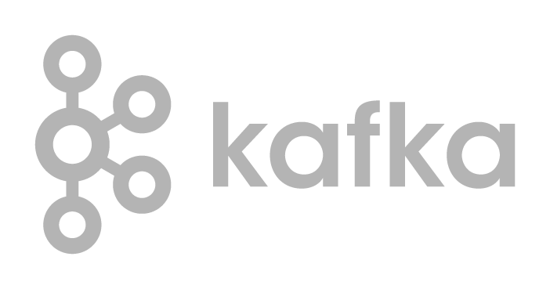
Saga pattern - Choreography
Each service produces and listens to other service’s events and decides if an action should be taken or not
Order MS
Voyage MS
Container MS
Ship MS
The distributed transaction ends when the last service executes.
Pending
5
2
3
4
1
orders
0
1
2
3
4
5
6
7
Notes:
the first service executes a transaction and then publishes an event. It maintains the business entity status, (order.status) to the pending state until it is completed. This event is listened by one or more services which execute local transactions and publish (or not) new events.
The distributed transaction ends when the last service executes its local transaction and does not publish any events or the event published is not heard by any of the saga’s participants.

Slide 19
Saga pattern - Choreography
In case of failure, the source microservice is keeping state and timer to monitor for the completion event.
Order MS
Voyage MS
Container MS
Ship MS
Error
1
2
orders
0
1
2
3
4
5
6
7
Notes:
Rolling back a distributed transaction does not come for free. Normally you have to implement another operation/transaction to compensate for what has been done before.

Slide 20
Saga pattern - Orchestration
One service is responsible to drive each participant on what to do and when.
Voyage commands
Voyage MS
Container MS
Ship MS
Order MS
Order
Orchestrator
0
1
2
3
4
5
0
1
2
3
4
0
1
2
3
4
5
Orders response
0
1
2
3
4
5
6
7
Notes:
If anything fails, it is also responsible for coordinating the rollback by sending commands to each participant to undo the previous operation.
orchestrator is a State Machine where each transformation corresponds to a command or message.
Rollbacks are a lot easier when you have an orchestrator to coordinate everything

Slide 21
Exception management
Technical exception
Retries
Timeout
Log for error handling
Admin API to replay from previous offset
Business exception (out of stock)
Compensation process

Slide 22
Saga
 | Choreography | Orchestration
Pros | + simple, does not require much effort to build + participants are loosely coupled. | Avoid cyclic dependencies between services Centralize the orchestration of the distributed transaction in one state machine Participants are simpler as they respond to command and send events
Cons | difficult to track which services listen to which events | Risk to have dump service and big brain orchestrator design command and response event structure
Fail over | Producers must ensure event delivery and idempotence to do not generate same order event multiple times Delivery once | Same logic needs to be done, but centralized in the orchestration component. Write to the Order response topics needs to be transactional
Rollback | Create compensation plan in the producer | Create compensation plan in the orchestrator
Notes:
Events/Choreography is a natural way to implement Saga’s pattern, it is simple, easy to understand, does not require much effort to build, and all participants are loosely coupled as they don’t have direct knowledge of each other.

Slide 23
Command Query Responsibility Segregation Pattern
Separate the read model from the write model
CUD on write model
… with basic read by ID, name….
Complex query done on Read model
How to join data / entities ?
APIs
Order MS
Write Model
Read Model
Projection
Data
https://ibm-cloud-architecture.github.io/refarch-eda/evt-microservices/ED-patterns/
Notes:
To join data entities, we need to consume events from other entities and build projection

Slide 24
Event Sourcing & CQRS
Order Dashboard Web
Order UI Web SPA
Order
BUSINESS
USER
END
USER
Complex Queries
Add, read by ID,
update Order
Order Command MS
Order Queries MS
Order Queries MS
BFF
OrderCreated
Event Backbone
0
1
2
3
4
5
6
7
Notes:
Now we separate the read model with complex queries as a separate microservice, scalable on demand,
The order data come to the Command API and are saved to the DB. An “OrderCreated” event is published with order data so other service could consume it. One of the services are the order query microservices, So they got a good view of the order.
But there is a new problem?
You may fail to save to the DB but send to the topic, or you may save and fail to send to the topic…. So we need XA transaction…. Which is not supported by Kafka. Kafka supports write transaction to the topic!

Slide 25

Command Query Responsibility Segregation Pattern
Order UI Web SPA
USER
Order Service
Order Command MS
Error Log
Write Model
4
5
Consumer
DB
CLI
3
6
1
2
Events
Topic
0
1
2
3
4
5
6
7
3
https://ibm-cloud-architecture.github.io/refarch-kc-order-ms/
Notes:
One way to support this 2 phases commit, is
1- to generate event with transaction, from the write model.
2- Then consume the event
3- write to the DB and commit the read offset
4- in case of write to the DB error, persist to an error log and notify administrator
5- Expose a CLI with admin API
6- So admin user can retrigger the consumer read operation from last committed offset.

Slide 26
Code Review
Open an IDE and go to the Java class: OrderCRUDService.java the function createOrder().
Support the post operation
Transform data to event
Use event emitter to kafka
Study the event producer: OrderProducer.java code which uses Kafka API.
Kafka configuration
Kafka consumer, Java Future.
Need to add circuit breaker.

Slide 27
OrderCommand Microservice main Class Diagram
@POST
Response create( OrderDTO o)
@PUT
Response update( OrderDTO o)
OrderCRUDService
emit( OrderEvent e)
handle( OrderEvent e)
EventEmitter
EventListener
handle( OrderEvent e)
@GET
Response getAll()
OrderAdminService
add( Order o)
getByID(String)
Update(Order o)
OrderDAO
ServletContextListener
KafkaConsumer delegates the event processing to OrderAdminService
EventLoop

Slide 28
Data Models
Data Transfer Objects
JSON
Order UI Web SPA
Order MS
Order id, addresses, customer id, product id, container id
Order specifics attributes
Status …
END
USER
{Customer id
Src and dest addresses
Product id,
Quantity,
Target delivery date }
Model = data payload as persistence entity
OrderCreated
OrderCancelled
OrderUpdated
OrderBooked
OrderDelivered…
Event type can be added easily

Slide 29
CQRS and CDC Pattern
Order Service
Order Query MS
Order Query MS
Order Command MS
Order Query MS
Write Model
Orders table
Read Model
Projection
Tx log
Projection
Projection
CDC Capture Agent
Events
orders
0
1
2
3
4
5
6
7
Notes:
Another way to implement this, is to use a Change Data Capture tool to create events from the order table transaction log.

Slide 30
IBM Event Streams Event Driven Application Patterns

Slide 31





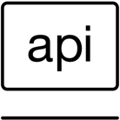
Mainframe / DB2 data to microservice
Mainframe core systems comprise batch jobs, online transactions, service components and user interfaces
The key organizing principle tends to be how and when code is executed
In cloud-native and microservices architecture, the organizing principles are based on domains, bounded contexts and aggregates.
https://www.ibm.com/cloud/garage/innovate/code/practices/domain-driven-design/
Notes:
without fully understanding what databases do today and the power that they bring and what relies on them — like transactions, concurrency, isolation, durability, materialized views, indexes — “We’re not fully understanding the principles of the decisions that were made of relational databases, [and] we can very quickly get into trouble reimplementing databases over API calls and implementing them much worse.
Bounded Context explicitly defines the boundaries of your model. This concept is critical in large software projects. A Bounded Context sets the limits around what a specific team works on and helps them to define their own vocabulary within that particular context. When you define a bounded context, you define who uses it, how they use it, where it applies within a larger application context, and what it consists of in terms of things like Swagger documentation and code repositories.

Slide 32
Coexistence
Strangler pattern is applied to legacy application
Fat Client Java Swing App
Rewrite a capability (product mgt) into event driven microservice
Write model on the new microservice
Read model stays in legacy so existing capabilities see new product added
iiop/ corba
Legacy runtime
IMS Transaction
Offers
Product
Customer
Programs
Business Actions
Data Accesses
DB2
Notes:
https://www.ibm.com/cloud/garage/architectures/application-modernization-v2/chunking-strategy-strangler-pattern

Slide 33
Coexistence integration patterns and tier 1 / tier 2 data
Standard Coexistence Integration Patterns
Current state core master data tables identified and categorized as tier 1 for increment planning
Current state reads modernized data directly
Modernized state updates current state data (reader support)
Current state updates modernized data
Modernized state reads current state data
Tier 1 Database Tables: Core master data tables identified as basis for modernized data model
Tier 2 Database Tables: Those tables that were NOT determined to be Core Master Data tables and are either application based, work tables, or temp tables. These tables may contain copies of core master table (tier 1) data from downstream operations
Requires modification when tier 1 programs are modified to read and process modernized data
Tier 1 Programs: Programs that perform update and / or read operations on the tier 1 tables
Tier 2 Programs: Programs that DO NOT perform any operations against the tier 1 tables, but receive core data downstream from either tier 1 programs or tier 2 tables
Requires modification when tier 1 programs are modified to read and process modernized data

Slide 34



1. Current state reads modernized data
Current State Application
Coexistence Integration
Modernized Application
Modernized to Current State
Transform services
Integration Services
Tier 2 Programs
Tier 1 Programs
Integration Layer
read
Modernized DB Read Service
MO
1
Invoke Read Service
API
read
Data Services
Transform Engine
Modernized Data Model
Tier 2 Data
Tier 1 Data
Usage
Pros
Cons
Examples
When modernized data to current state data transformation complexity minimal
When performance requirements allow real time transformation for reading modernized data from the current state
Current state tables / views decommissioned
Minimal change to tier 1 and no change to tier 2 programs
Reuses design / develop efforts for data migration
Potential performance impacts of converting data on the fly when transform is complex
Current state constraints may inhibit use of all benefits of modernized data model (i.e. utilization of game changer features may be delayed to subsequent roll outs)
Current state table(s) are eliminated, but an current state report program still needs new expanded field in modernized data (e.g. modified to use expanded customer name)
A status code, indicator, or flag value is needed on the current state that was transformed into a new value set when loaded to the modernized data model

Slide 35
2. Modernized state updates current state data (reader support)
Current State Application
Coexistence Integration
Option 1:
Transaction capture
Modernized Application
Modernized to Current State
Transform services
Integration Services
Tier 2 Programs
Tier 1 Programs
Integration Layer
Capture Update
Current State DB Update Service
MO
1
Data Services
Transform Engine
Modernized Data Model
DB
2
Apply Update
Capture Update
Option 2:
Change Data Capture (CDC)
Tier 2 Data
Tier 1 Data
Usage
Pros
Cons
Examples
When update effort for tier 1 and tier 2 components is too large for current modernization roll out scope
When the current state constraints are minimal
No current state tier 1 / tier 2 changes required
Coexistence service development typically less effort
Reuses design / develop efforts for data migration
Current state remains decoupled from modernized solution
Modernized data updates applied synchronously or asynchronously depending on performance needs
Current state tables / views remain
Current state constraints may inhibit use of all benefits of modernized data model (i.e. utilization of game changer features may be delayed to subsequent roll outs)
Critical reports need current state data format that cannot be changed in the timeframe planned for a given modernization roll out
Critical business owned applications need replica of current state key data that cannot be changed in the timeframe planned for a given modernization roll out

Slide 36
3. Current state updates modernized data
Current State Application
Coexistence Integration
Option 1:
Transaction Capture
Modernized Application
Integration Services
Tier 2 Programs
Tier 1 Programs
Integration Layer
Option 1:
Transaction Capture
Apply Update
Trans-action Capture API
MO
1
Data Services
Transform Engine
Option 2:
Change Data Capture (CDC)
Option 2:
Change Data Capture (CDC)
Change Data Capture (CDC)
Modernized Data Model
DB
2
Current State to Modernized
Transform services
Apply Update
Tier 2 Data
Tier 1 Data
Modernized DB Update Service
Usage
Pros
Cons
Examples
When current state processes are required to update the modernized database that were not able to be rolled out, but the respective current state database table was decommissioned
To support the roll out of modernized data to a new modernized inquiry (read only) process where current state data needs to be “forward sync’d” to the modernized database.
Current state tables / views decommissioned
Minimal changes to tier 1 program(s), no changes to tier 2 programs
Reuses design / develop efforts for data migration
Current state remains decoupled from modernized solution
Potential performance impacts of converting data on the fly when transform is complex
Potential need to update asynchronously to minimize impact on current state
A complex batch job, in part or as a whole is not modernized along with a given modernization roll out, but a status code or aggregated value needs to be transformed and updated on the modernized database since the current state equivalent table was decommissioned
Forward sync’ing data from current state database to modernized database to support modernized inquiry processes.

Slide 37
4. Modernized state reads current state data
Current State Application
Coexistence Integration
Modernized Application
Integration Services
Tier 2 Programs
Tier 1 Programs
Data Services
Modernized Data Model
DB
2
Current State to Modernized
Transform services
Tier 2 Data
Tier 1 Data
Current State DB Read Service
Usage
Pros
Cons
Examples
When modernized solution needs data that has not yet been modernized
Supports incremental modernization roll out where modernized data and current state data can be brought together in context within the modernized application
None
The modernized solution needs customer data reflected in the modernized user interface that has not yet been added to the modernized data model (e.g. Customer Name)

Slide 38
Data Replication Pattern
Fat Client Java Swing App
iiop/ corba
HTTP/ Json or XML
Legacy runtime
New write
REST APIs
IMS Transaction
Cloud native runtime clusters
Offers
Customer
Product Mgr MS
Transform Engine
Programs
Kafka Producer
Read current state data
Business Actions
Data Accesses
productAdded
productUpdated
DB2
PostgreSQL
Products Topic
Kafka Connect Cluster
0
1
2
3
4
5
6
7
Worker
Products
22 tables
Worker
[productID, values, TS]
Notes:
the Variant Mgr microservice includes a kafka producer component that produces events like variantAdded, variantUpdated
The major motivation is to move to a pub/sub event sourcing pattern

Slide 39

Combining CDC with Kafka
Fat Client Java Swing App
iiop/ corba
New write
Legacy runtime
REST APIs
IMS Transaction
Cloud native runtime clusters
Item
Customer
Product Mgr MS
Other MS
Programs
Worker
Business Actions
PostgreSQL
Apply Agent
Data Accesses
logs
Apply / Transform Agent
0
1
2
3
VPN | TLS
DB2
products Topic
Kafka Connect Cluster
Server
0
1
2
3
4
5
6
Worker
Z Capture Agent
Capture Agent
Capture Agent
Worker
Management console
[variantKey, values, TS]
Notes:
To replicate both directions we need logical partitioning: the new to old is for propagating write model to read only tables, so legacy features can see new records. The path from old to new, is more on stable records, maybe reference data, and this is to build data views and projections for the microservices context.

Slide 40
Orders table to kafka
1 table to 1 topic mapping
Topic acts as a transaction log
DB operations are implemented by record writes to a Kafka topic
Legacy runtime
RDBMS
Orders
Orders
0
1
2
3
4
5
6
(24, (24, “abc”)),
[ primary_key, values]
Cloud native runtime clusters
source
(key,values)
sink
RDBMS
Notes:
Representing DB2 table to distinct Kafka topic
A unique row in a DB2 table is represented by the Kafka record’s “Key”
The “Kafka Key” is comprised of a subset of the columns in the DB2 table which make the row unique
The “Kafka Key” is comprised of a subset of the columns in the DB2 table which make the row unique
Could be a unique index or the primary index defined on the DB2 table
Also possible for the rows to logically be unique, needn’t be a created index
The Kafka record’s “Value” contains the current values for all columns in the row
The messages in a topic represent the changes to the rows of a table over time
At any given sample offset in the topic, taking the most recent value up to that point for each unique key in the topic gives the original DB2 table at that point
Sample offset most useful if at a transaction boundary
For table orders ( orderID int, anAttribute varchar (30))
A Kafka mapping might use orderID=24 as the key value.
The Topic for orders (Topic_orders) might consist of the following (key,value) pairs: (24, (24, “abc”)), (25,(25, “def”)), (24, (24, “ghi”))
The aggregate result of these records would be a table with 2 rows: (24, “ghi”), (25, “def”)
Operations are implemented by record writes to a Kafka topic
Deletes
•Kafka represents a delete as a record with a key and null for the value.
•To represent a delete of the row with i1 value 1, send the (key, value) pair (1, null)
•New users often confused when they view values and simply see null.
•Displaying the key portion of the record is useful. (print.key=true)
Updates
•If the value being updated is not part of the key, an update is simply an insert.
•To represent a row update of (1, “abc”) to (1, “ghi) send the (key, value) pair (1,(1, “ghi”))
•If the value being updated is a key, it is represented by a delete record and an insert record.
•To represent the update of row (1, “abc”) to (5, “abc”) send two (key, value) pair records (1, null) , (5, (5,“abc”))

Slide 41
Table operations
Table Operation | Kafka records | Example
Insert row | Publish (newKey, values) | (orderID:24, {orderID:24, name: smith})
Update row | Publish (existingKey, values) | (orderID:24, {orderID:24, name: smithy})
Delete row | Publish (existingKey, null) | (orderID:24, null)
Notes:
Deletes
•Kafka represents a delete as a record with a key and null for the value.
•To represent a delete of the row with i1 value 1, send the (key, value) pair (1, null)
•New users often confused when they view values and simply see null.
•Displaying the key portion of the record is useful. (print.key=true)
Updates
•If the value being updated is not part of the key, an update is simply an insert.
•To represent a row update of (1, “abc”) to (1, “ghi) send the (key, value) pair (1,(1, “ghi”))
•If the value being updated is a key, it is represented by a delete record and an insert record.
•To represent the update of row (1, “abc”) to (5, “abc”) send two (key, value) pair records (1, null) , (5, (5,“abc”))

Slide 42
Using kafka for table replication
General Advantages
Offload Processing
Aggregation of Data From multiple Sources
Common Platform for Staging to Other Data Consumers
Storage System For Duplicating Important Data
Buffer Unprocessed Messages
Offers Throughput and Low End-to-End Latency
Offers Real Time Processing and Retrospective Analysis
Can Correlate Streaming Feeds of Disparate formats

Slide 43
Using kafka for table replication
General Advantages
Can Correlate Streaming Feeds of Disparate formats
Flexibility of Input Source and Output Targets
Built in Stream Processing on Real Time Feeds
Flexibility Supporting Business Logic Layering Or Programmatic Interpretation
Commit Log
Statistics
Red Flag Monitoring
Fault Tolerance, Scalability, multi-tenant nature, speedy, light-weight, landing-zone

Slide 44
Challenges
Format Choice
A Kafka record Key and Value are bytes
Producer and Consumer must come to an agreement about the meaning of the bytes in the key/value
Producers may have written data months before a consumer receives it
Communicating Table Schema
Records in a topic are relevant in the context of a specific schema
What if a tables schema were to change?
How can a consumer know the schema at the time the record was sent?
Network throughput maximization
Consumer processing considerations
Notes:
A Kafka record Key and Value need only be bytes to satisfy the Kafka Producer/Consumer protocol
Producer and Consumer must come to an agreement about the meaning of the bytes in the key/value
Producers may have written data months before a consumer receives it
Network throughput maximization
Consumer processing considerations
Communicating Table Schema
Records in a topic are relevant in the context of a specific schema
What if a tables schema were to change?
How can a consumer know the schema at the time the record was sent?
•Tracking the effective point in a source transaction operation sequence that has been applied to Kafka
•Non ACID target
•“at least once” semantics

Slide 45
Challenges
Tracking the effective point in a source transaction operation sequence that has been applied to Kafka
Non ACID target
“at least once” semantics
Notes:
•Tracking the effective point in a source transaction operation sequence that has been applied to Kafka
•Non ACID target
•“at least once” semantics

Slide 46
IBM DR Architecture
Legacy runtime
Business App
Replication Solution
RDBMS
Management console
RDBMS
Server
Server
doc
Orders
Capture Agent
messaging
Apply / Transform Agent
[ primary_key, values]
logs
Network
Data lake
Store procedure

Slide 47

IIDR Architecture on k8s?
Legacy runtime
IIDR management console
Business App
Worker Node
RDBMS
Worker Node
Server
Worker Node
Worker Node
RDBMS
Kubelet
Kubelet
doc
IIDR Capture Agent
Orders
IIDR Kafka Agent
IIDR Access Server
orders
[ primary_key, values]
Kafka
Kafka Connect Sink
Data lake
logs
PV - metadata
Zookeeper
Store procedure

Slide 48
CDC Architecture on k8s?
IIDR management console
Legacy runtime
Business App
Worker Node
Worker Node
Worker Node
Worker Node
Worker Node
RDBMS
Kubelet
Kubelet
Kubelet
Orders
IIDR Access Server
IIDR Capture Agent
[ primary_key, values]
Kafka
RDBMS
Kafka Connect Sink
logs
IIDR Kafka Agent
Zookeeper
Store procedure
PV - metadata

Slide 49
Mainframe / DB2 data to microservice - refactoring
Revisit existing function and procedure and elaborate service interface
Service boundaries are not part of an entity or aggregate.
Mainframe functions could become operation of a service
Business rules should be externalized with their own life cycle and runtime as service
Mainframe
Cobol procedure
RDBMS
Cobol procedure
SQL proc
Domain Boundary /
Functions Refactoring
Cluster nodes
Business rules refactoring
Business Rules
As service
Order Microservice
Notes:
without fully understanding what databases do today and the power that they bring and what relies on them — like transactions, concurrency, isolation, durability, materialized views, indexes — “We’re not fully understanding the principles of the decisions that were made of relational databases, [and] we can very quickly get into trouble reimplementing databases over API calls and implementing them much worse.

Slide 50
Integrate DB2 data to event backbone (option 1)
Existing Clients
Applying CQRS and event sourcing
Mainframe
Order Query MS
New Clients
RDBMS
Cobol procedure
Write Model
API Gateway
Read Model
SQL proc
Kafka producer
Projection
Theory!
Orders
0
1
2
3
4
5
6
7
1 table to 1 topic mapping
Notes:
Attention this theory and nice on the slide. The cobol code is modified to generate events… Transaction boundary is lost anyway as there is no XA tx in kafka. But there is a may be a less intrusive ways to make it.

Slide 51
Kafka connect architecture
Legacy runtime
Connect Cluster
Broker Server
Kafka Streams
RDBMS
Worker
KStream - KTable
containers
Orders
Worker
a b c d e
Broker Server
[ primary_key, values]
Broker Server
Worker
Sink

Slide 52

Integrate DB2 data to event backbone (option 2)
Existing Clients
Mainframe
Transform Data Models
Order Query MS
RDBMS
Cobol procedure
Write Model
New Clients
API Gateway
Read Model
SQL proc
Projection
CDC Servers
Change Data
Capture
Transform Data Models
Orders
0
1
2
3
4
5
6
7
IBM Data Replication CDC
CDC Replication Engine for Kafka

Slide 53

Integrate event backbone using MQ (option 3)
Existing Clients
Mainframe
Transform Data Models
Order Query MS
RDBMS
Cobol procedure
Write Model
New Clients
API Gateway
Read Model
SQL proc
MQ
Projection
Orders
Transform Data Models
0
1
2
3
4
5
6
7
IBM Data Replication CDC
CDC Replication Engine for Kafka

Slide 54


IBM Event Streams | Integrates with IBM MQ
Send push notifications
Transactions
Alerts
IBM MQ connects mission-critical Systems of Record, requiring transactional, once-only delivery, e.g. payment transactions
IBM Event Streams distributes and processes streams of events in real-time to intelligently engage with customers, e.g. alerts on spending patterns
Notes:
Written by, and supported by, experts in both MQ and Kafka/Event Streams
Built-in understanding of MQ enterprise deployments, for example to handle high availability configurations and maintenance regimes
Well-tuned connectors (source and sink) which take messages off an MQ queue and streams them onto a Kafka topic and vice versa
Anything additional is left in the hands of the MQ operations team, so they get no surprises in MQ resource usage
Confluent only supports 1-way connectivity. Their connector can also result in poor use of MQ topic subscriptions or message selectors leaving messages building up unchecked
IBM’s unique knowledge of MQ message structures has enabled the connectors to extract event info from a range of message formats, and put the right data onto Kafka topics, including custom records if needed
IBM has added support for the MQ connectors to run directly on IBM z/OS so they can take advantage of bindings mode for improved operational efficiencies

Slide 55
Kafka Connect MQ Source connector
Open-source – build it yourself
Use any supported MQ release
Uses JMS client internally
Client connections
Supports TLS, authentication
MQ queue->Kafka topic
Support for binary, text, JSON
Easy to extend
MQ Source connector
RecordBuilder
Converter
TO.KAFKA.Q
FROM.MQ.TOPIC
MQ Message
SourceRecord
Kafka Record
MQMD
Schema
Null key
(MQRFH2)
Value
(may be complex)
Value
byte[]
Payload
https://github.com/ibm-messaging/kafka-connect-mq-source

Slide 56
Kafka Connect MQ Sink connector
Open-source – build it yourself
Use any supported MQ release
Uses JMS client internally
Client connections
Supports TLS, authentication
Kafka topic -> MQ queue
Support for binary, text, JSON
Easy to extend
MQ Sink connector
Converter
MessageBuilder
TO.MQ.TOPIC
FROM.KAFKA.Q
Kafka Record
SinkRecord
MQ Message
Key
Schema
MQMD
Value
byte[]
Value
(may be complex)
(MQRFH2)
Payload
https://github.com/ibm-messaging/kafka-connect-mq-sink

Slide 57
Unlock Events from Systems where Kafka Connectivity is a Problem
REST API for Inbound Data
IBM Event Streams
HTTP
z/OS Connect
HTTP
HTTP
REST API
Applications
57
Notes:
New REST api, to publish events to kafka without programming with lower level API.

Slide 58
Event Driven Application Patterns

Slide 59
General Guidance
From event storming you should have identified
Events, commands, actors, business entities
- Business domain with subdomains
Now you can derive
Bounded contexts, aggregates
Microservice candidates
End to end solution for the domain and subdomains
Structure of the microservices

Slide 60
Event Storming Outcomes
Shipping inc Clerk
Domain: Fresh Good Shipment
Sub domain: Reefer Container
Add Reefer Container to inventory
Container added to inventory
Whenever shipment order is created, reserve container
Whenever shipment order delivered, release container
Remove Reefer Container inventory
Container removed from inventory
Assign Container to order
Release Container from order
Set Reefer Container in maintenance
Container in maintenance
Container assigned to order
Container released from order
Release Reefer Container from maintenance
Container off maintenance
1
2
3
Notes:
Here we focus on the sub domain of the Reefer container

Slide 61
Domain Driven Design
A technique for developing software that focuses on collaboration between technical experts and domain experts.
The ideas and terms of the domain should be directly reflected by the code through the Ubiquitous Language.
A language appears consistently in all the communication forms used by the team
Based on the domain experts’ language
The language should also be embedded in the code
Keep the language, model and code in sync

Slide 62
Bounded Contexts
The entire business model is too large and complex to understand as a unit.
Not feasible to maintain a unified model for an entire enterprise.
We need to mark boundaries and relationships between different models.
A Bounded Context is an explicit boundary within which a domain model exists. Inside the boundary all terms and phrases of the Ubiquitous Language have a specific meaning, and the model reflects the Language with exactness.

Slide 63
Reefer-container-shipment context
Order Context
Container Context
Order
Container

Slide 64
Container Bounded Context
Container on truck
Container on vessel
Container off truck
Container off vessel
Add Container to inventory
Container added to inventory
Container removed from inventory
Container loaded
Container:
Type
Location
Capacity
Brand
Status
Container landed at location
Assign Container to order
Container unloaded
Container assigned to order
Release Container to order
Container released from order
Container door closed
Container in maintenance
Container door opened
Remove Container from inventory
Container out maintenance

Slide 65
Principals of Microservices
Modelled around business domain
Ubiquitous language
Rely only on the public API
Hide your implementation details / data
Document your APIs
Define a versioning strategy
Use the right tools for the job
Container Journey
Polyglot persistence (data layer)
Polyglot frameworks (app layer)
Secure your services
Defence-in-depth
Authentication/authorization
Highly observable
Have SLAs
Distributed monitoring, logging, tracing
More than just technology transformation
Embrace organizational change
Favour small focused dev teams
Better software faster
Continuous deployment
Think of resiliency upfront
65

Slide 66
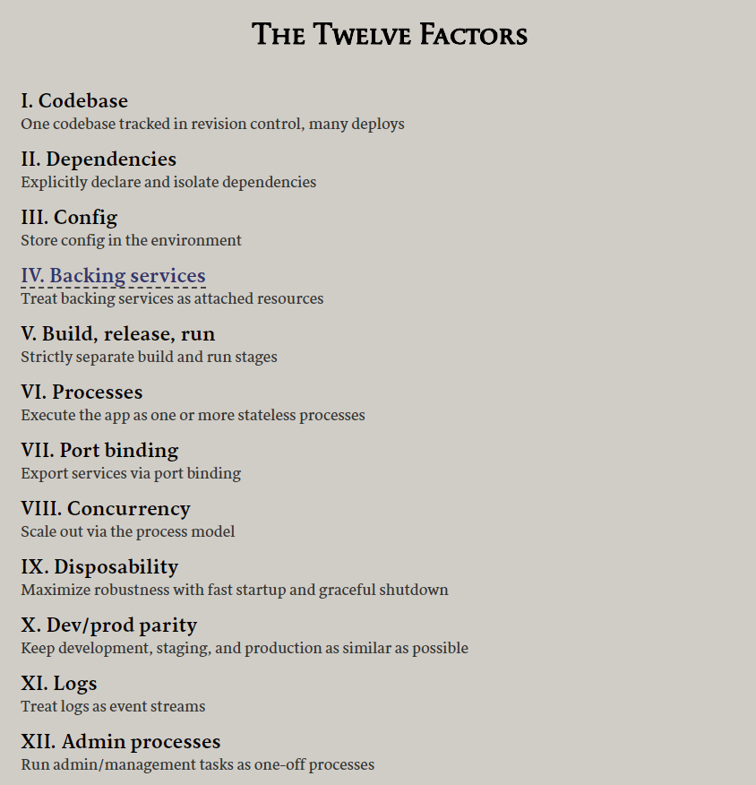
12 Factor Apps
https://12factor.net/
The Twelve-Factor App methodology is a methodology for building software as a service applications.
Drafted by developers at Heroku and was first presented by Adam Wiggins @ 2011
These set of best practices were designed to enable applications to be built with portability and resilience when deployed to the web.
It applied to cloud native application naturally
66

Slide 67
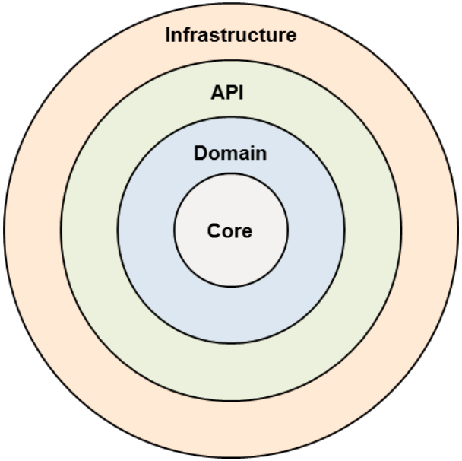
Microservice structure
Core is the building blocks not specific to any domain or technology, containing generic building blocks like Lists, Maps, Case Classes, Actors and Lenses
Domain is where all business logic resides with classes and methods named using the ubiquitous language for the domain. BUSINESS LOGIC GOES HERE!
API acts as the entry point to the domain, using Domain terms and objects from the Domain. API should only expose immutable objects to prevent developers from using the exposed objects to gain access to the underlying domain, thus manipulating the domain. It can access the Core and the Domain but not the Infrastructure.
Infrastructure is the outermost layer containing adapters for various technologies such as databases, user interface and external services. It has access to all areas of the system, such as API, Domain and Core

Slide 68
Some best practices on Event driven microservice
Design for Sources and Sinks
Identify data sources, streaming flow and sinks to make sure flow is created from end-to-end.
Message Content and Identifiers
Define the content and IDs for a message so that processing of messages are more efficient.
Monitoring and Performance:
Have correlation ids across message flow , so that transaction monitoring can be enabled/analyzed with Splunk or Datadog etc..
Consumer groups and topic partitions
Define consumer groups based on similar type of messages and also follow standard way of defining topics and consumer names

Slide 69
Reliability
Producer can choose acknowledgement level (request.required.acks)
0 Fire-and-forget, fast but risky
1 Waits for 1 broker to acknowledge
-1 All Waits for all replica brokers to acknowledge
Producer can choose whether to retry
0 Do not retry, lose messages on error
>0 Retry, might results in duplicates on error
Producer can also choose idempotence
Means that retries can be used without risk of duplicates

Slide 70
Reliability
Consumer can choose how to commit offsets
Automatic: commits might go faster than processing
Manual, asynchronous: Fairly safe, but could re-process messages
Manual, synchronous: Safe, but slows down processing
A common pattern is to commit offsets on a timer
Exactly-once semantics
Can group sending messages and committing offsets into transactions
Primarily aimed at stream processing applications

Slide 71
IBM Cloud Functions
IBM Cloud Functions is an event-driven compute platform, that runs code in response to events or direct invocations.
API Gateway: Expose Actions as and API, and management for configuration (e.g. security, vanity urls, etc.)
Triggers: Defines the link to a certain type of event by event source.
Rules: Bind a trigger with a specific action
Actions: Code that performs a specific task, written in the language of your choice
Event Driven
Request Driven
Triggers
API Gateway
Actions
Node
Java
Swift
Python
PHP
Containers
https://www.ibm.com/cloud/functions

Slide 72
Event Driven Application Patterns

Slide 73

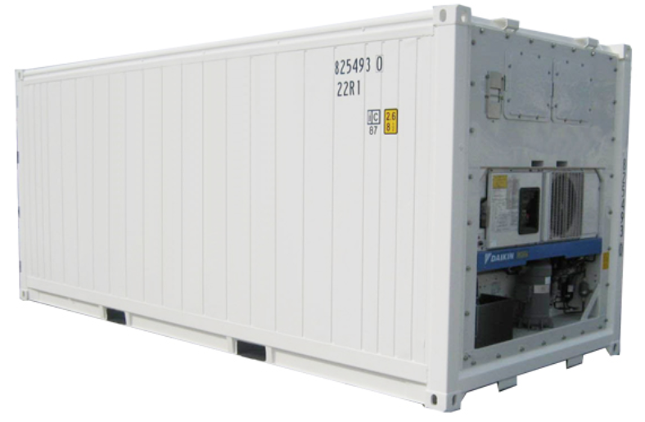






Architecture
Cloud native app
Data Ingestion
Event driven microservice
Event driven microservice
Change Data Capture
Data in motion
0
1
2
3
4
mqtt
HTTP
Data Storage
Real Time Analytics
Streams Analytics
Kafka Streams
Data Science

Slide 74

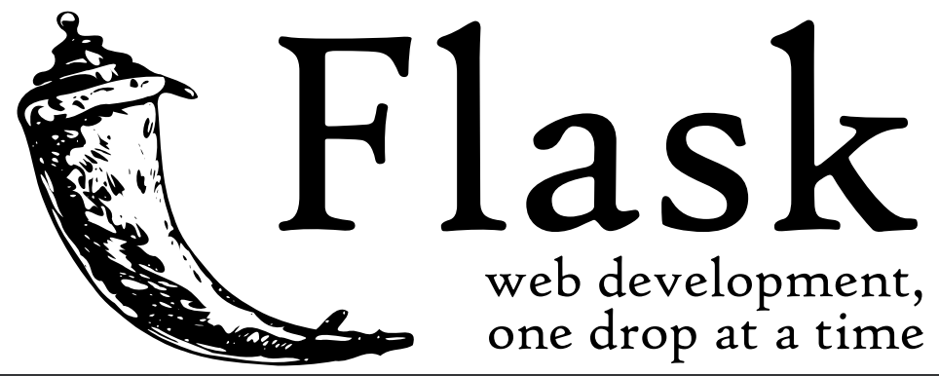

ML runtime architecture
Curl …
2
4
Predictive Scoring
1
Reefer Simulator
Kafka Producer
containerMetrics
3
Python Flask
0
1
2
3
4
5
6
7
0
1
2
3
4
5
6
containers
Container Consumer
https://ibm-cloud-architecture.github.io/refarch-reefer-ml/
Notes:
What to consider:
-

Slide 75
Integrate to Partition from ML env
ContainerMetrics
Jupiter notebook
0
1
2
3
4
5
6
7
Training Set
Test Set
Simulator
Create Container Metrics
Maintenance Manual Transcript Notes
Model
Scoring risk of failure in next x hours
Predictive maintenance
Data Scientist focus

Slide 76

















IBM Streaming Analytics
Filter / Sample
Transform Correlate
Classify
Annotate
Streams to Act on All Your Data in Real Time

Slide 77
IBM Streams Analytics Out of the box with over 200 operators with 1300 functions
Communications Data Sources
TCP/IP
UDP/IP
HTTP
FTP
RSS
Messaging Toolkit (Kafka, XMS, IBM MQ, Apache ActiveMQ, RabbitMQ, MQ TT, MQ Low Latency Messaging)
IBM Data Replication
Hadoop
Hadoop
HDFS, GPFS, Hive, Hbase, BigSQL, Parquet, Thrift, Avro
IBM Streams
Scale-out Runtime
RDBMS
IBM DB2, IBM DB2 Parallel writer, IBM Informix, IBM BigInsights BigSQL, IBM Netezza, IBM Netezza NZLoad, solidDB, Oracle, Microsoft SQL Server, MySQL, Teradata, Aster, HP Vertica
Data Warehouse
Primary Analytics
NoSQL
NoSQL
Key Value Stores (HyperState Accelerator, Memcached, Redis, Redis-Cluster, Aerospike)
Column Oriented Stores (Cassandra, Hbase)
Document Oriented Stores (IBM Cloudant, Mongo, Couchbase)
Filter
Enrich
Normalize
Windowed Aggregations
Machine Learning
Scoring (SPSS, Python, R, MLlib)
Signal Processing
CEP & Pattern Matching
xDR Mediation
Geospatial
Video/Image
Text Analytics (AQL)
Speech to Text
Rules
Deep Packet Inspection
Application Development
Java
Scala
Python
Streams Processing Language (Drag & Drop)
And even more at github.com/IBMStreams

